Slide 1

STOCK MARKET: BEHAVIOUR DURING CORONAVIRUS Group 003-001 Ricardo Calleja Jose Toro Patricio Ramirez Cristian Salinas
St. Clair College Fall 2022

Slide 2
CONTENTS
Backgrond / Motivation.
Problem statement.
Problem proposal.
Analysis questions.
Dataset description.
Steps we expect to perform on our datase.

Slide 3

01.
Background / Motivation.

Slide 4

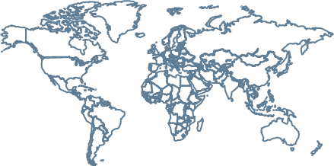
Background / Motivation.
Pandemics are cyclicals (Ex. Ebola 2013, Spanish flu 1918 ), and they had an economic impact. Since during the covid-19 outbrake a high volatility impacted the economy, it is our purpose to identify what companies and sectors did well which went wrong on the SP500.

Slide 5
02.
Problem Statement.

Slide 6

”
The raise of economic uncertainty during Covid-19 pandemic, increased investment risk. Understanding the behavior of economic actor, could be used as a guideline for similar events in the future.

Slide 7
03.
Problem proposal

Slide 8

Problem proposal
Create a descriptive analysis to comprehend the behavior of the companies that belongs to SP500 index before (January-March 2019), during (January-March 2020) and after COVID-19 outbreak.

Slide 9
04.
Analysis Questions

Slide 10

1) How each economic sector performed in financial terms during the pandemic? 2) How each company performed in financial terms during the pandemic? 3) Which company had the best performance by market capitalization variation?

Slide 11
05.
Dataset Description

Slide 12
Dataset Description
1) The dataset to be used comes from Yahoo Finance API and it includes stock price, share quantity and a description of each company within the SP500.
2) It covers 3 periods (January-March for the year 2019, 2020 and 2021)

Slide 13
06.
Steps we expect to perform on our dataset

Slide 14

Steps we expect to perform on our dataset
Merge Dataset
Consolidate the datasets: S&P500 companies, Shares S&P 500, Average stock price per trimester (2019,2020,2021)
Clean Database
Clean the data that can generate negative effects on the final result
Clean Database
Analyze the data before coming to any assumption
Visualizations
1
2
3
4
Find any NA (if there exist).
Identify outliers.
Identify irregularities.
Describe the data.
Understand the dataset.
Identify segments or groups.
Identify head and tail.
Generate preliminary visualizations.
Explain how was the data collected
Show the information in a comprehensive way

